Slide 1
April 12, 2023

Slide 2

Gentle Introduction to Machine Learning: Statistics
A Reproducible Research Workshop
Simon Stone
Research Data Services
Dartmouth College

Slide 3
About the Reproducible Research Group
Joint venture of Research Computing @ ITC and Research Data Services @ Library
Consult with experts on
research data management,
data visualization,
biomedical research support,
spatial data and GIS,
high performance and research computing,
statistical analysis,
economics and social sciences data
Meet the people on campus that support your reproducible research lifecycle
Engage in community discussions to learn from other researchers on campus
Attend a workshop to learn practical tools and tips

Slide 4
About Research Data Services
Research Data Management
Data Management Plans (DMPs) for sponsored projects
Finding and using 3rd party data
Collection and cleaning of data
Organization and documentation
Publishing and Repositories
Data Analysis/Visualization
Textual, numeric, spatial data
Reproducible research workflows
Scripting in R: tidyverse core package (i.e., ggplot, dplyr, tydr, tibble, etc.)
Scripting in Python: NumPy, SciPy, Pandas, Scikit-learn, Matplotlib, Seaborn, (OpenCV, PyTorch, TensorFlow, Tesseract, NLTK, etc.)
Computational Scholarship
Computational project planning
Collections as Data
Storytelling with data and visualizations
Text and data mining
Digital Humanities support
Computational Pedagogy

Slide 5
Work with us
ResearchDataHelp@groups.dartmouth.edu
Jeremy Mikecz Research Data Science Specialist jeremy.m.mikecz@dartmouth.edu dartgo.org/jeremyappts | Simon Stone Research Data Science Specialist simon.stone@dartmouth.edu dartgo.org/meetwithsimon
Lora Leligdon Head of Research Data Services lora.c.leligdon@dartmouth.edu dartgo.org/lora

Slide 6
Gentle Introduction to Machine Learning Intro
Activity:
Why are you here?
What do you hope to take away from this workshop (series)?

Slide 7
Gentle Introduction to Machine Learning Intro
Machine Learning is ”the field of study that gives computers the ability to learn without explicitly being programmed.”
- Arthur Samuel, 1959 (paraphrased)
Machine Learning
Deep Learning
Artificial General Intelligence
Machine Learning is what we should call (the current) Artificial Intelligence!

Slide 8
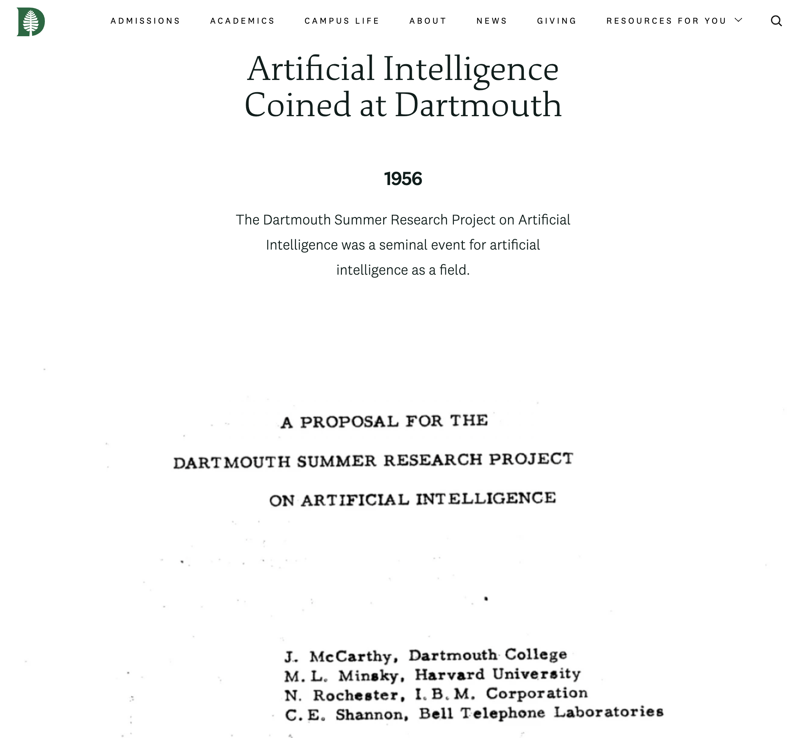
Gentle Introduction to Machine Learning Intro
https://home.dartmouth.edu/about/artificial-intelligence-ai-coined-dartmouth

Slide 9
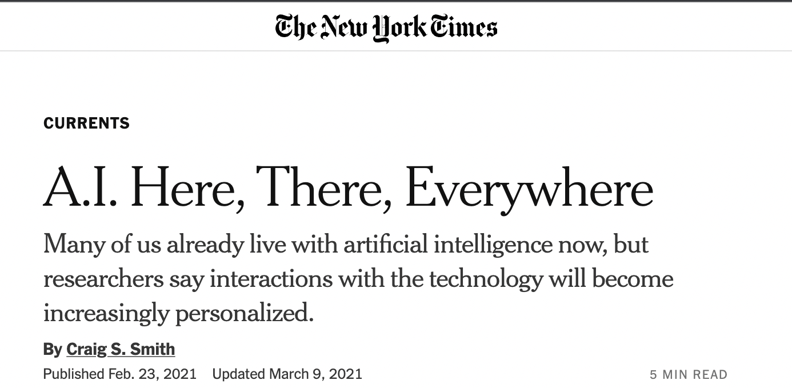
Gentle Introduction to Machine Learning Intro
Machine Learning is everywhere
We are interacting with it every day
But how much do most of us know about our new algorithmic overlords?

Slide 10
Gentle Introduction to Machine Learning Intro
Aims of this series:
Demystify the field a bit and give context to the buzzwords
A working mental model how machine learning algorithms think calculate
To provide enough knowledge to think critically about “A.I.”
To inspire you to confidently use machine learning in your work and personal life

Slide 11
Gentle Introduction to Machine Learning Intro
Statistics
A brief survey of the fundamentals for Machine Learning
Regression (April 25)
How can an algorithm find relationships between two variables?
Classification (May 9)
How can an algorithm put a label on a real-world object?

Slide 12
Basics Intro
Activity:
Define “Statistics”
One definition (Upton & Cook, 2008):
“The science of collecting, displaying, and analysing data.”
In Machine Learning:
“The way that algorithms perceive the world”

Slide 13
Basics Intro
Two sides of the (fair) coin:
Descriptive Statistics
Describing an apparent mess of data
Inferential Statistics
Making predictions based on a mess that represents a larger mess

Slide 14
Basics Intro
Descriptive Statistics
Inferential Statistics
Every machine learning model, ever:
Descriptive Statistics
Inferential Statistics
Mystery Box
Descriptive Statistics
Inferential Statistics
Input data
Output data

Slide 15
Descriptive Statistics Random Process, Variable, Data
Data: Recorded pieces of information
Random Variable: The underlying characteristic or quantity observed through data
Random Process:
Assigning a value (data) to a variable randomly
random ≠ arbitrary
The deterministic internals of the process are not known
The process is described by how likely it is to observe a specific value

Slide 16
Descriptive Statistics Sample, Population
Population:
The entirety of a group of interest (e.g., everyone at Dartmouth)
Sample:
The relatively few examples from the population that were observed (e.g., survey respondents)

Slide 17
Descriptive Statistics Types of data
Data: Recorded pieces of information
Variable: The underlying characteristic or quantity observed through data
Activity:
We want to statistically describe the population of people at Dartmouth to a machine learning model.
Pair up and identify some variables that may help us do that

Slide 18
Descriptive Statistics Types of data
Categorical data (qualitative)
Data which can be divided into groups
May have inherent order (ordinal scale) or not (nominal scale)
Numerical data (quantitative)
Data which is in the form of numbers with mathematical meaning
Can be discrete (e.g., the count of books) or continuous (e.g., the cost of books)

Slide 19
Descriptive Statistics Visualizing Data
Example:
Rolling a six-sided die
100 observations (i.e., rolls)
How can we visualize the results in a diagram?
What would you expect to see?

Slide 20
Descriptive Statistics Visualizing Data
Demo

Slide 21
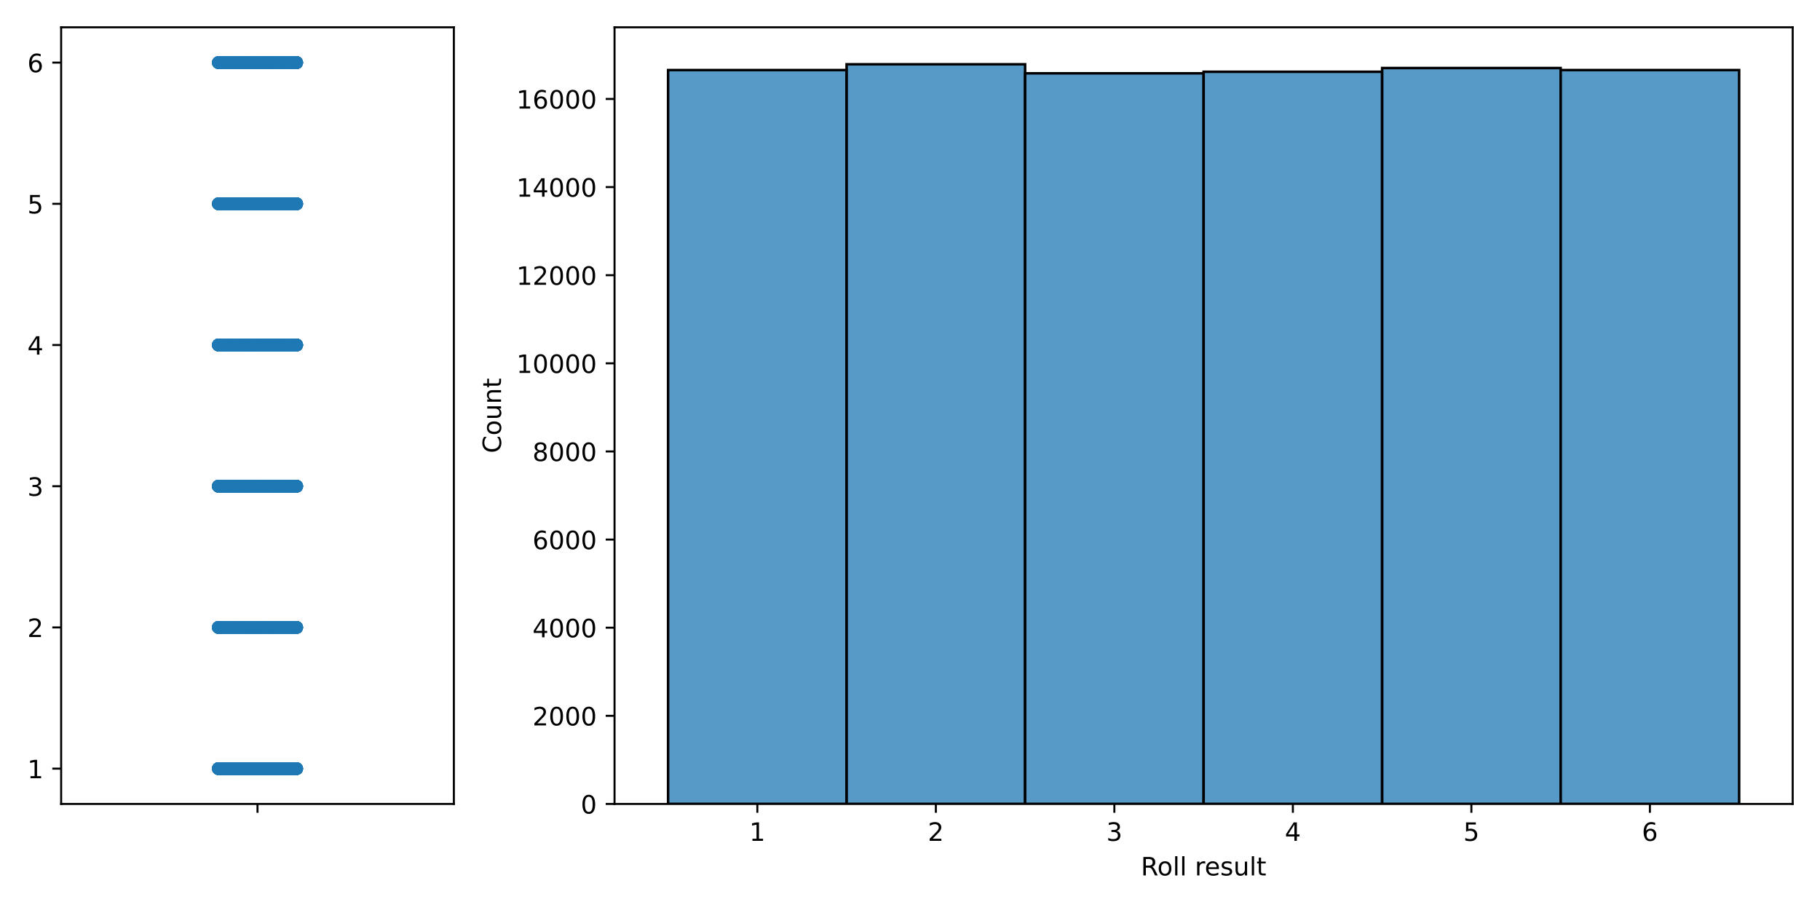
Descriptive Statistics Visualizing Data: Discrete uniform distribution

Slide 22
Descriptive Statistics Visualizing Data
Example:
🎲 Rolling multiple six-sided dice
🎲 100 observations (i.e., rolls)
What would you expect to see now?

Slide 23
Descriptive Statistics Visualizing Data
Demo

Slide 24
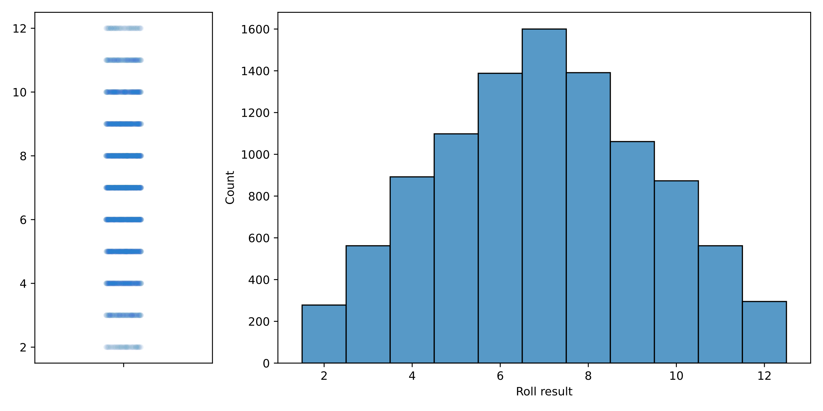
Descriptive Statistics Visualizing Data: Discrete non-uniform distribution

Slide 25
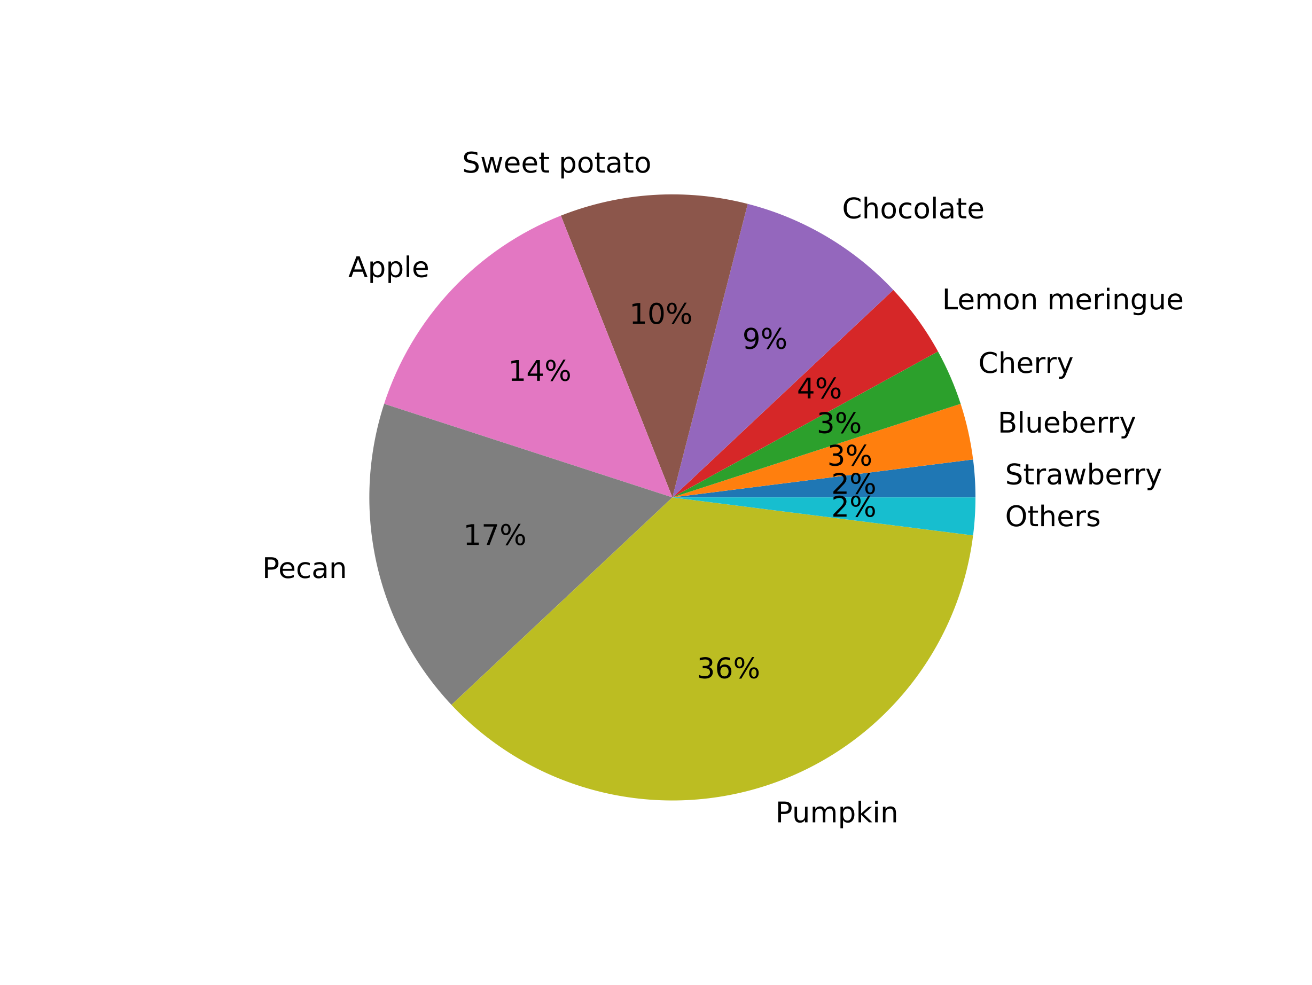
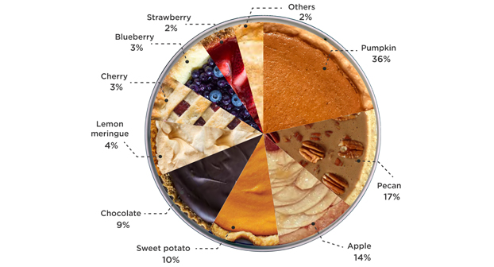
Descriptive Statistics Visualizing Data: Categorical distribution
Source:
Thanksgiving Pie Survey Breaks Down America’s Favorites. (2017). Delta Dental. URL: https://www.deltadental.com/us/en/about-us/press-center/2017/thanksgiving-pie-survey-breaks-down-america-s-favorites.html

Slide 26
Descriptive Statistics Visualizing Data: Categorical distribution
”Which chocolate bars have you bought in the past 3 months?”
Note(s): United States; December 6 to 15, 2021; 18 years and older; 373 respondents; respondents who buy chocolate bars for their household regularly
Further information regarding this statistic can be found on page 8.
Source(s): Statista Consumer Insights; ID 1093537

Slide 27
Descriptive Statistics Summarizing data
Challenge:
We cannot define a deterministic function that describes the observed data
How can we provide a compact representation of the sample?

Slide 28
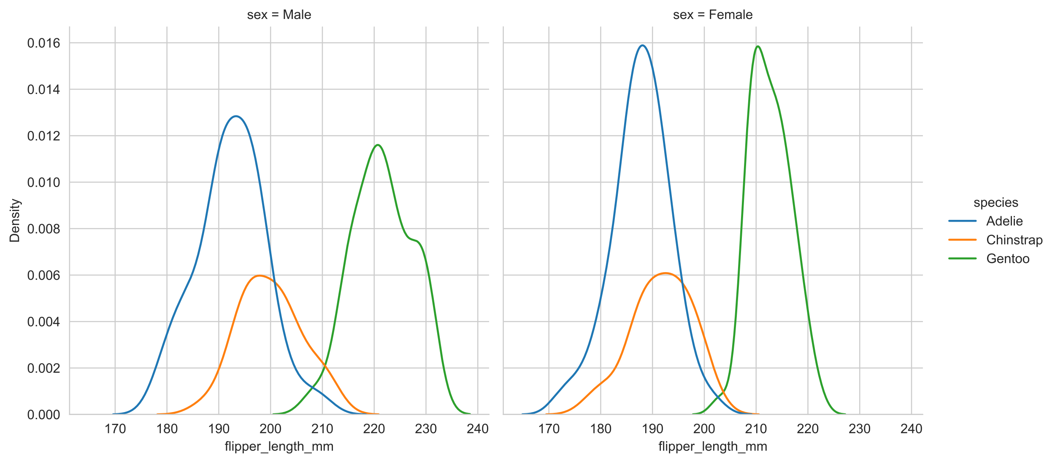
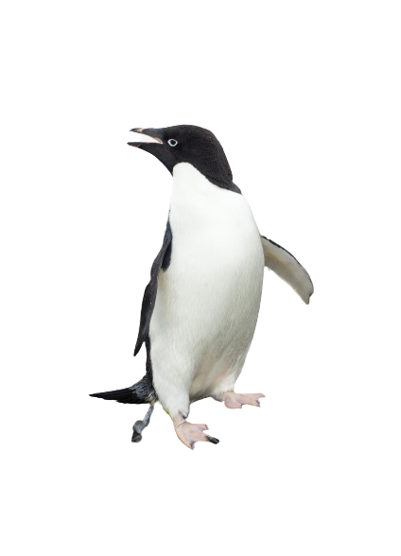
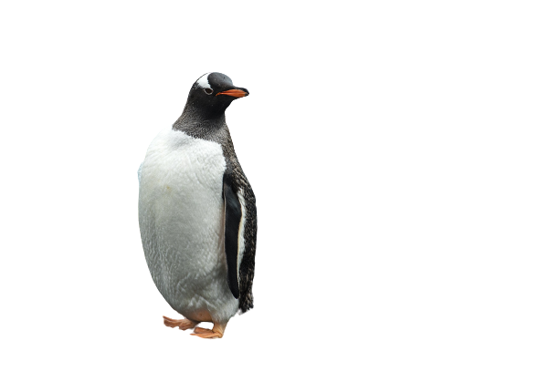
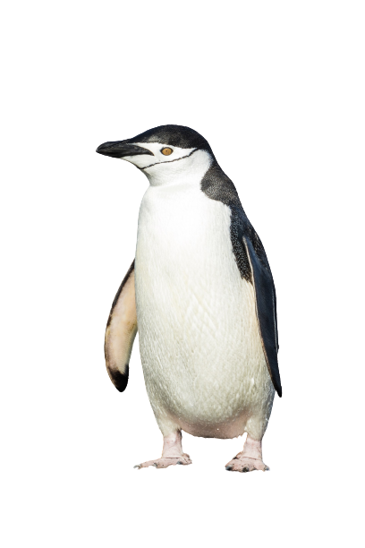
Descriptive Statistics Summarizing data
Activity: How would you describe these observed distributions?

Slide 29
Descriptive Statistics Summarizing data
Percentiles
How do the observations spread out?
Measures of Central Tendency
What is a “typical” observation?
Measures of Variability
How much do observations vary from the “typical” one?

Slide 30
Descriptive Statistics Summarizing data: Percentiles
Sort the data ascendingly

Slide 31
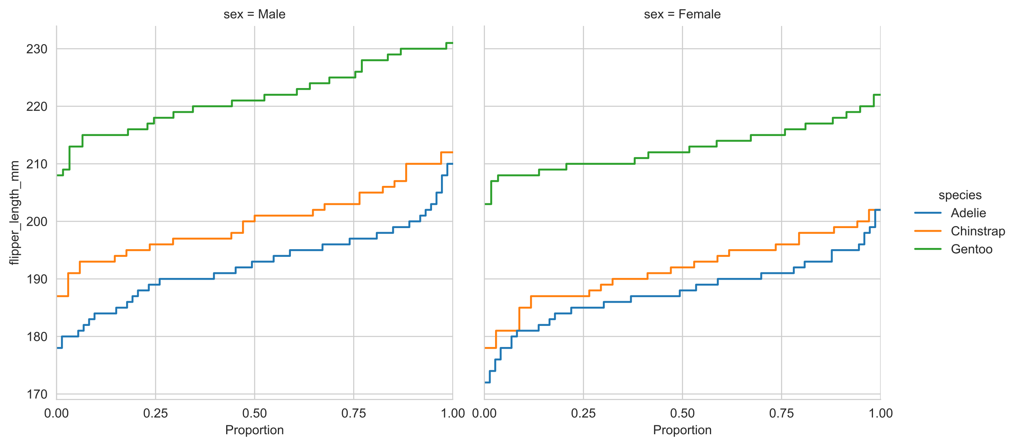
Descriptive Statistics Summarizing data: Percentiles
Sort the data ascendingly
Divide the data into groups
Four groups: quartiles
Five groups: quantiles
X groups: 1/X percentiles
The five magic numbers:
Lowest, 25 %, 50 %, 75 %, Largest
0 %
25 %
50 %
75 %
100 %

Slide 32
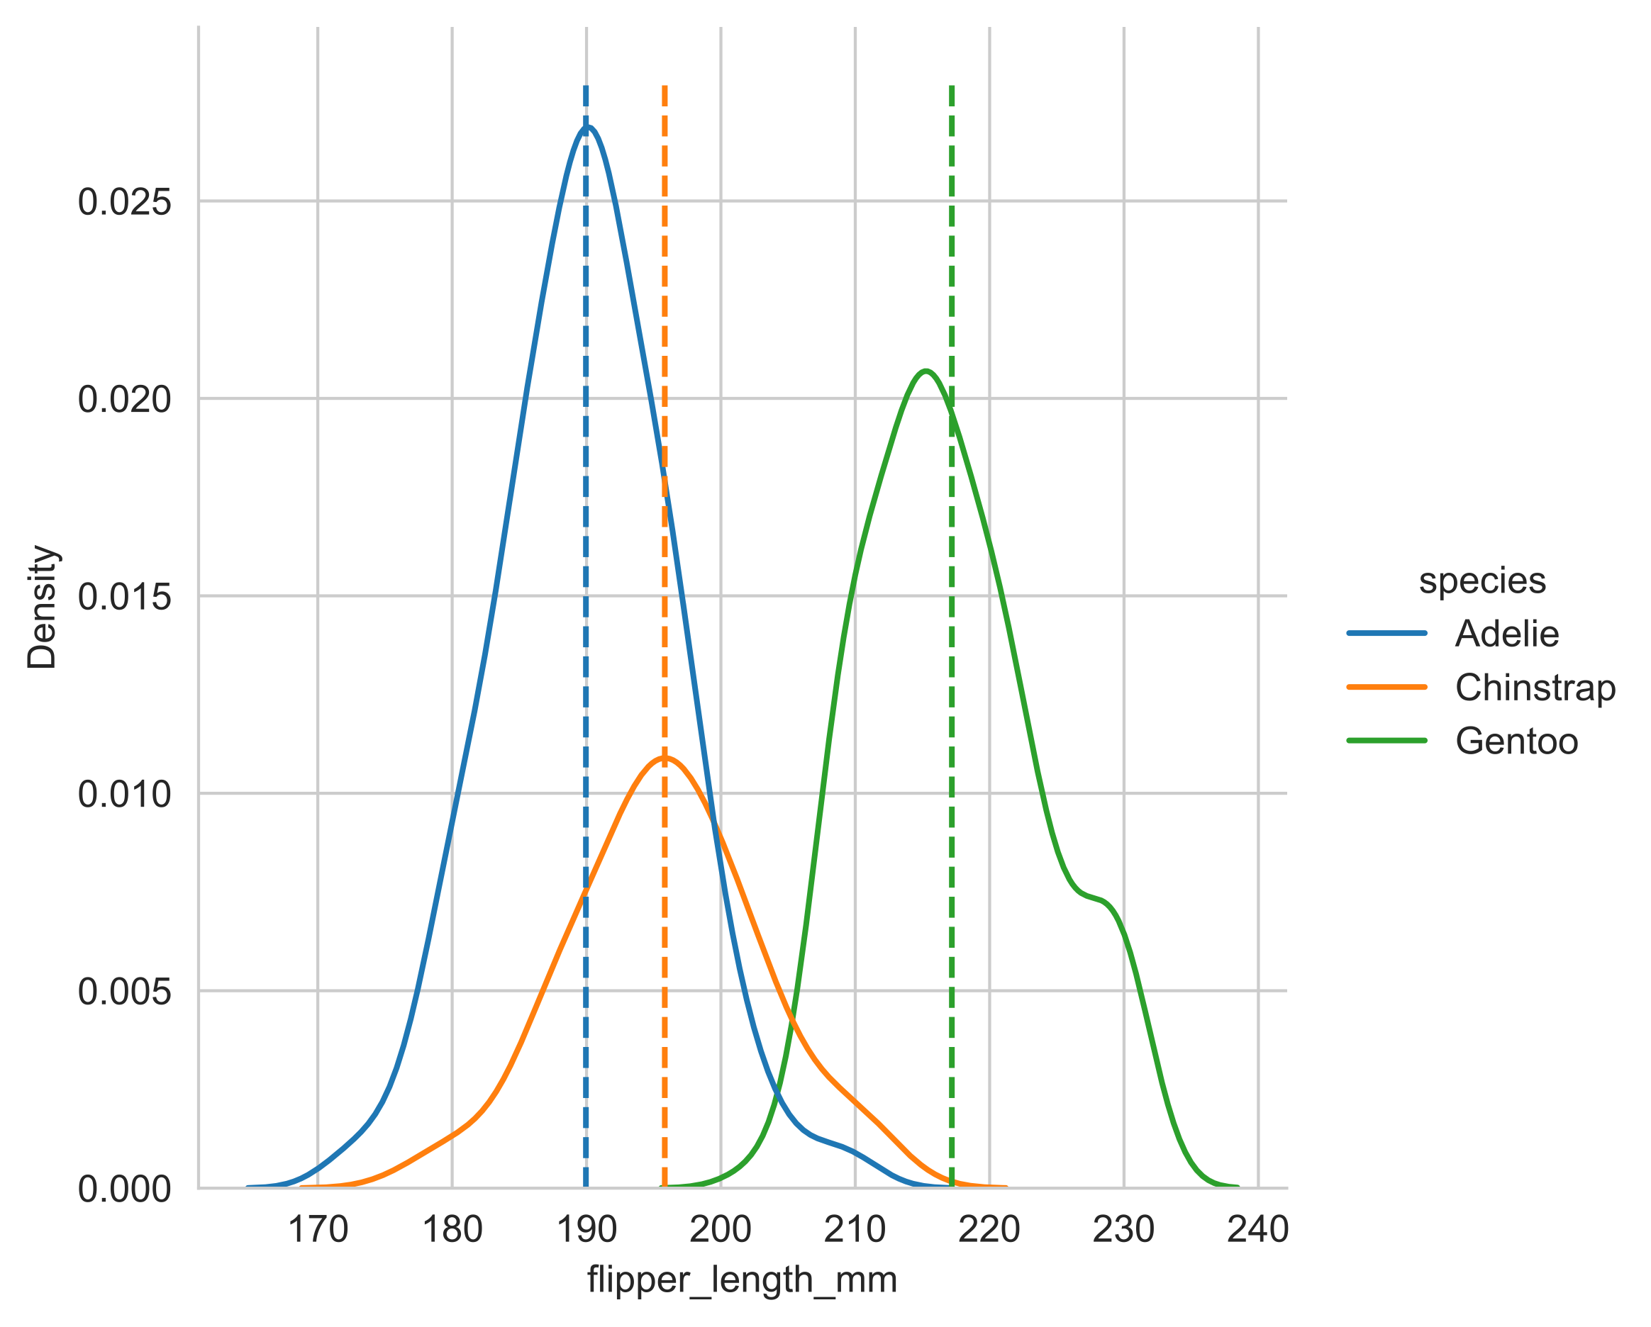
Descriptive Statistics Summarizing data: Measures of Central Tendency
Mean:
Sum up all observations
Divide by number of observations
Interpretation:
Typical observation

Slide 33
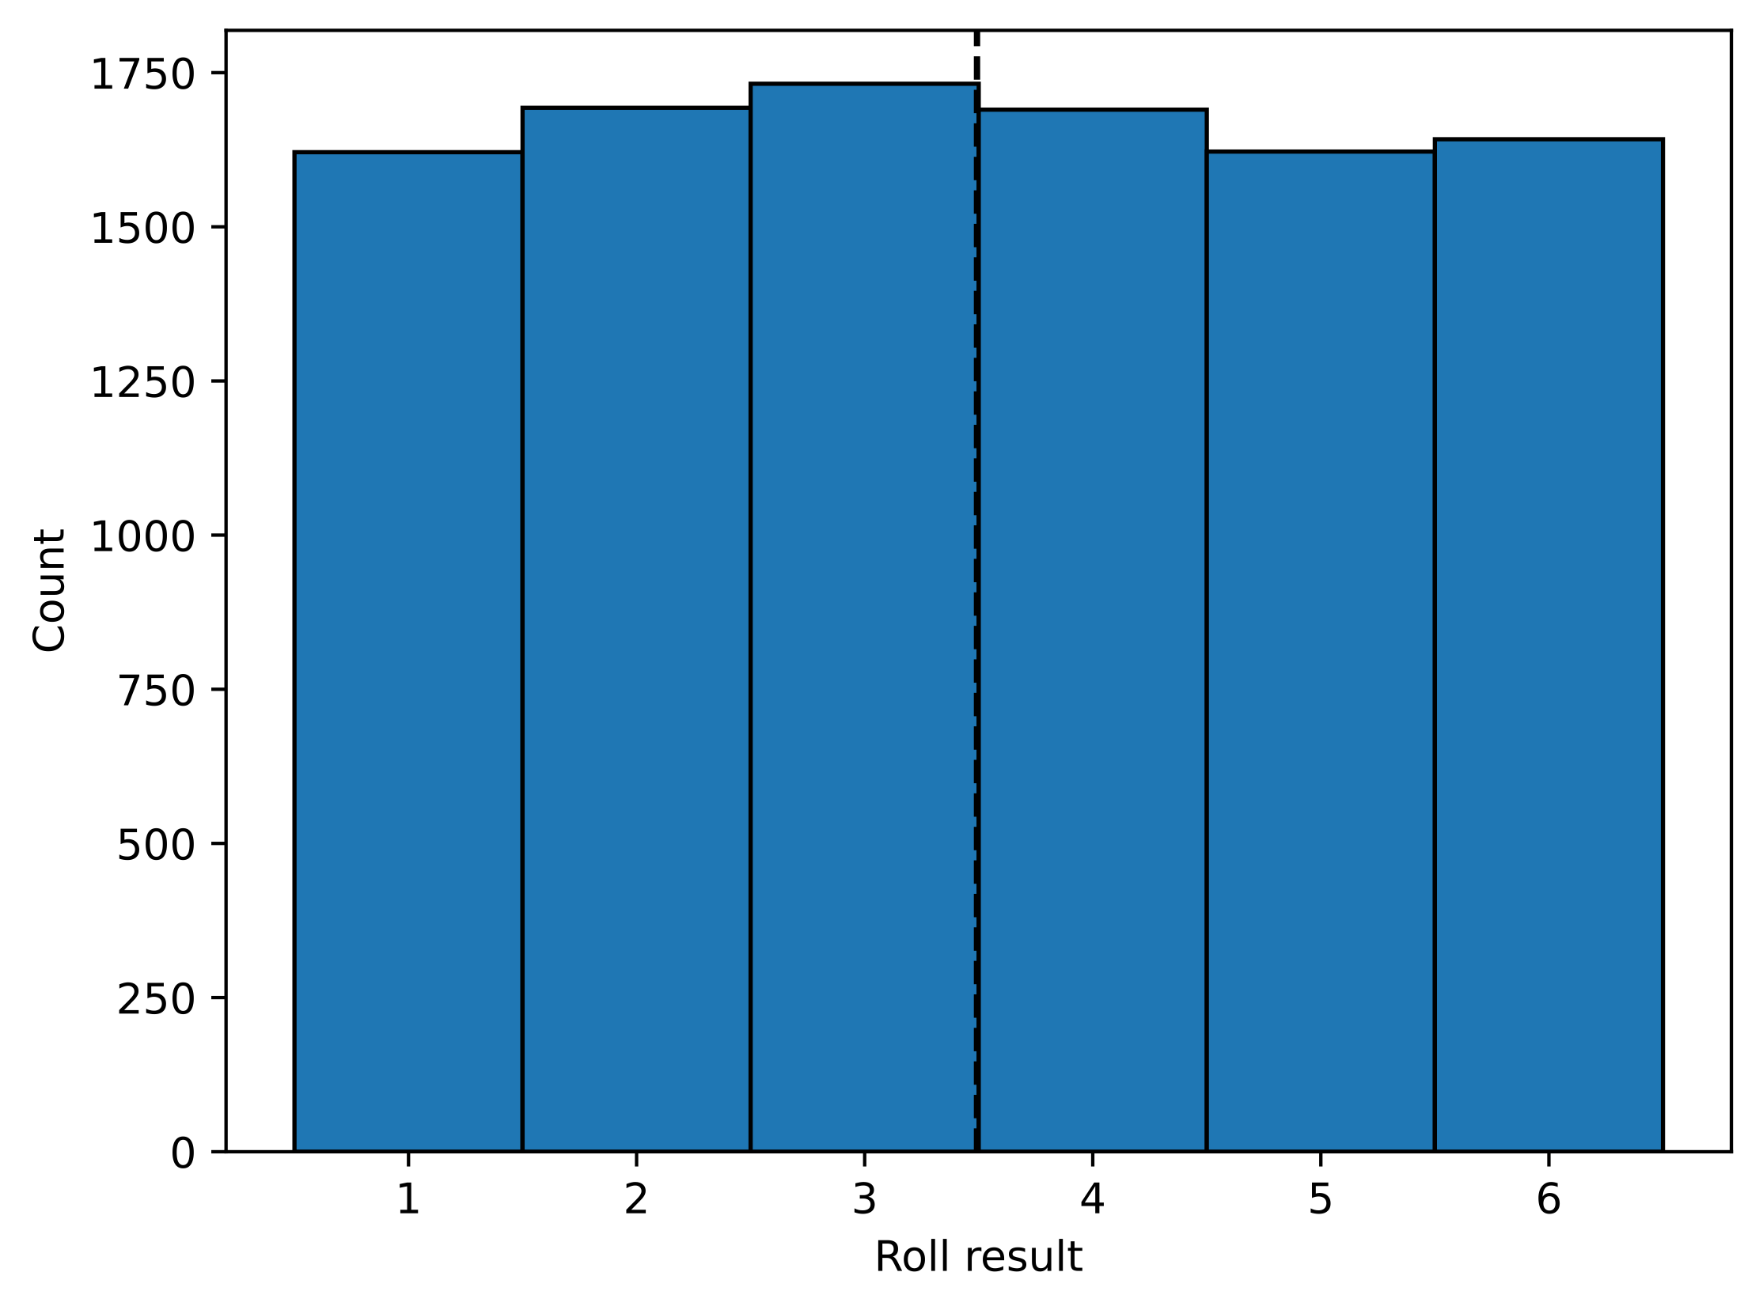
Descriptive Statistics Summarizing data: Measures of Central Tendency
Mean:
Sum up all observations
Divide by number of observations
Interpretation:
Typical observation
Expected value: “If you expect this value, you are probably the least wrong”
No guarantee that this value was actually observed!

Slide 34
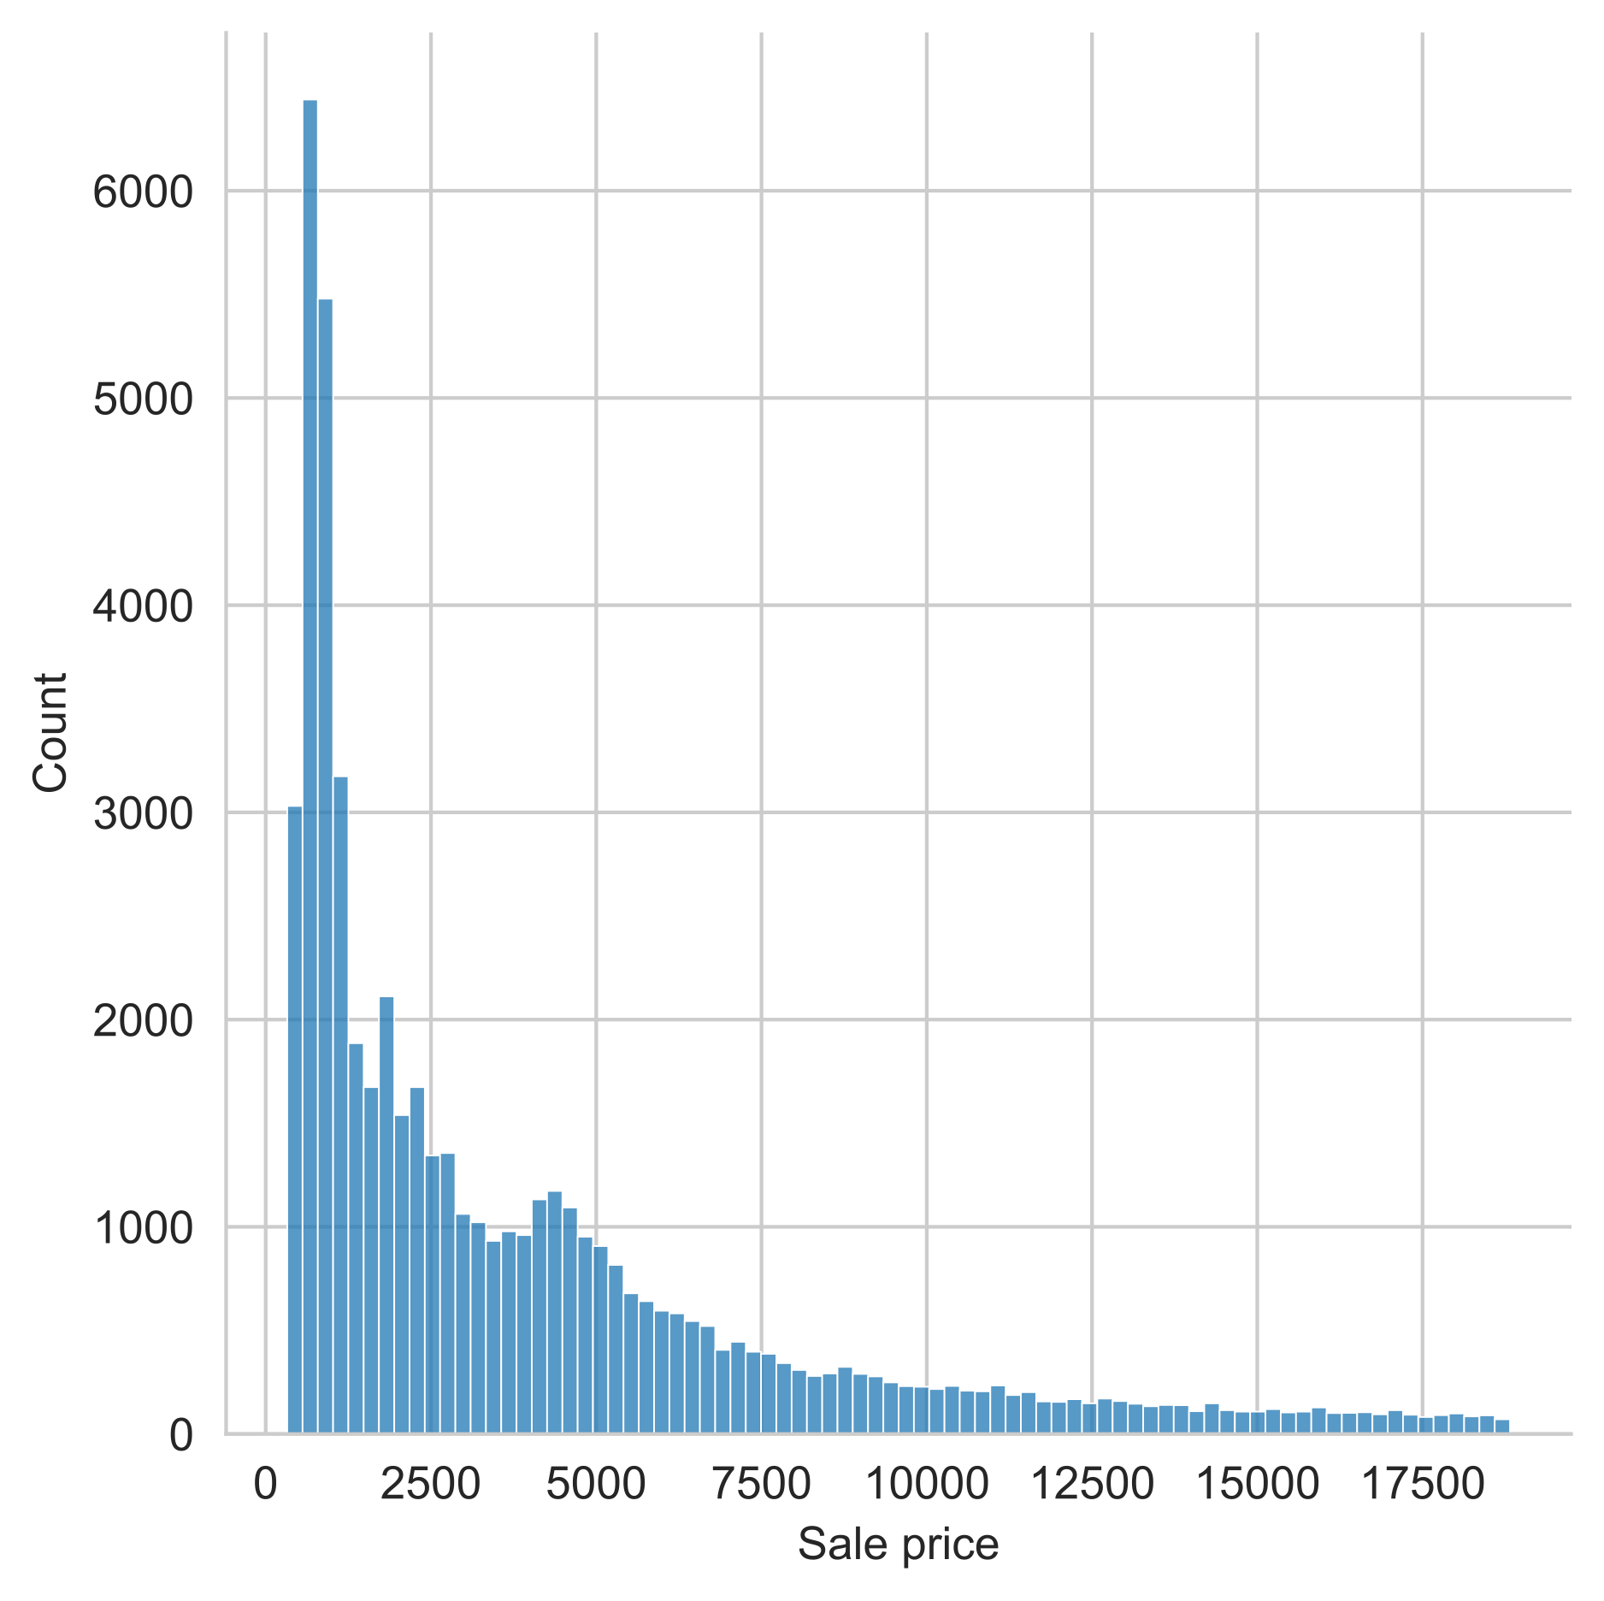
Descriptive Statistics Summarizing data: Measures of Central Tendency
Median:
Sort all observations
Pick the one in the middle
Interpretation:
Typical example from the dataset
Half of the observations are smaller, half are bigger
Median: 2401
Mean: 3933

Slide 35
Descriptive Statistics Summarizing data: Measures of Central Tendency
Mode:
Count each occurrence of a value
The most frequent one is the ‘mode’
Interpretation:
The value you are most likely to observe if you pick an example from the sample at random

Slide 36
Descriptive Statistics Summarizing data: Measures of Central Tendency
 | Mean | Median | Mode
Interpretation: | “Least-error expectation” | Half-way point in the data | Most likely to observe this
Defined for: | Numeric data | Sortable data | Categorical

Slide 37
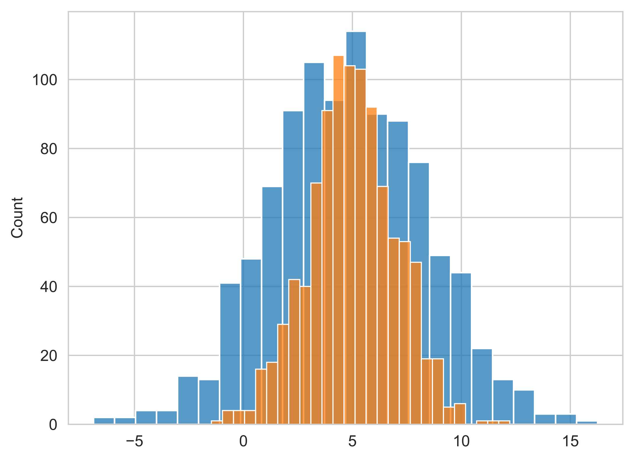
Descriptive Statistics Summarizing data: Measures of Variability
Two distributions with the same mean (µ = 5.0)
Question:
What makes them different?

Slide 38
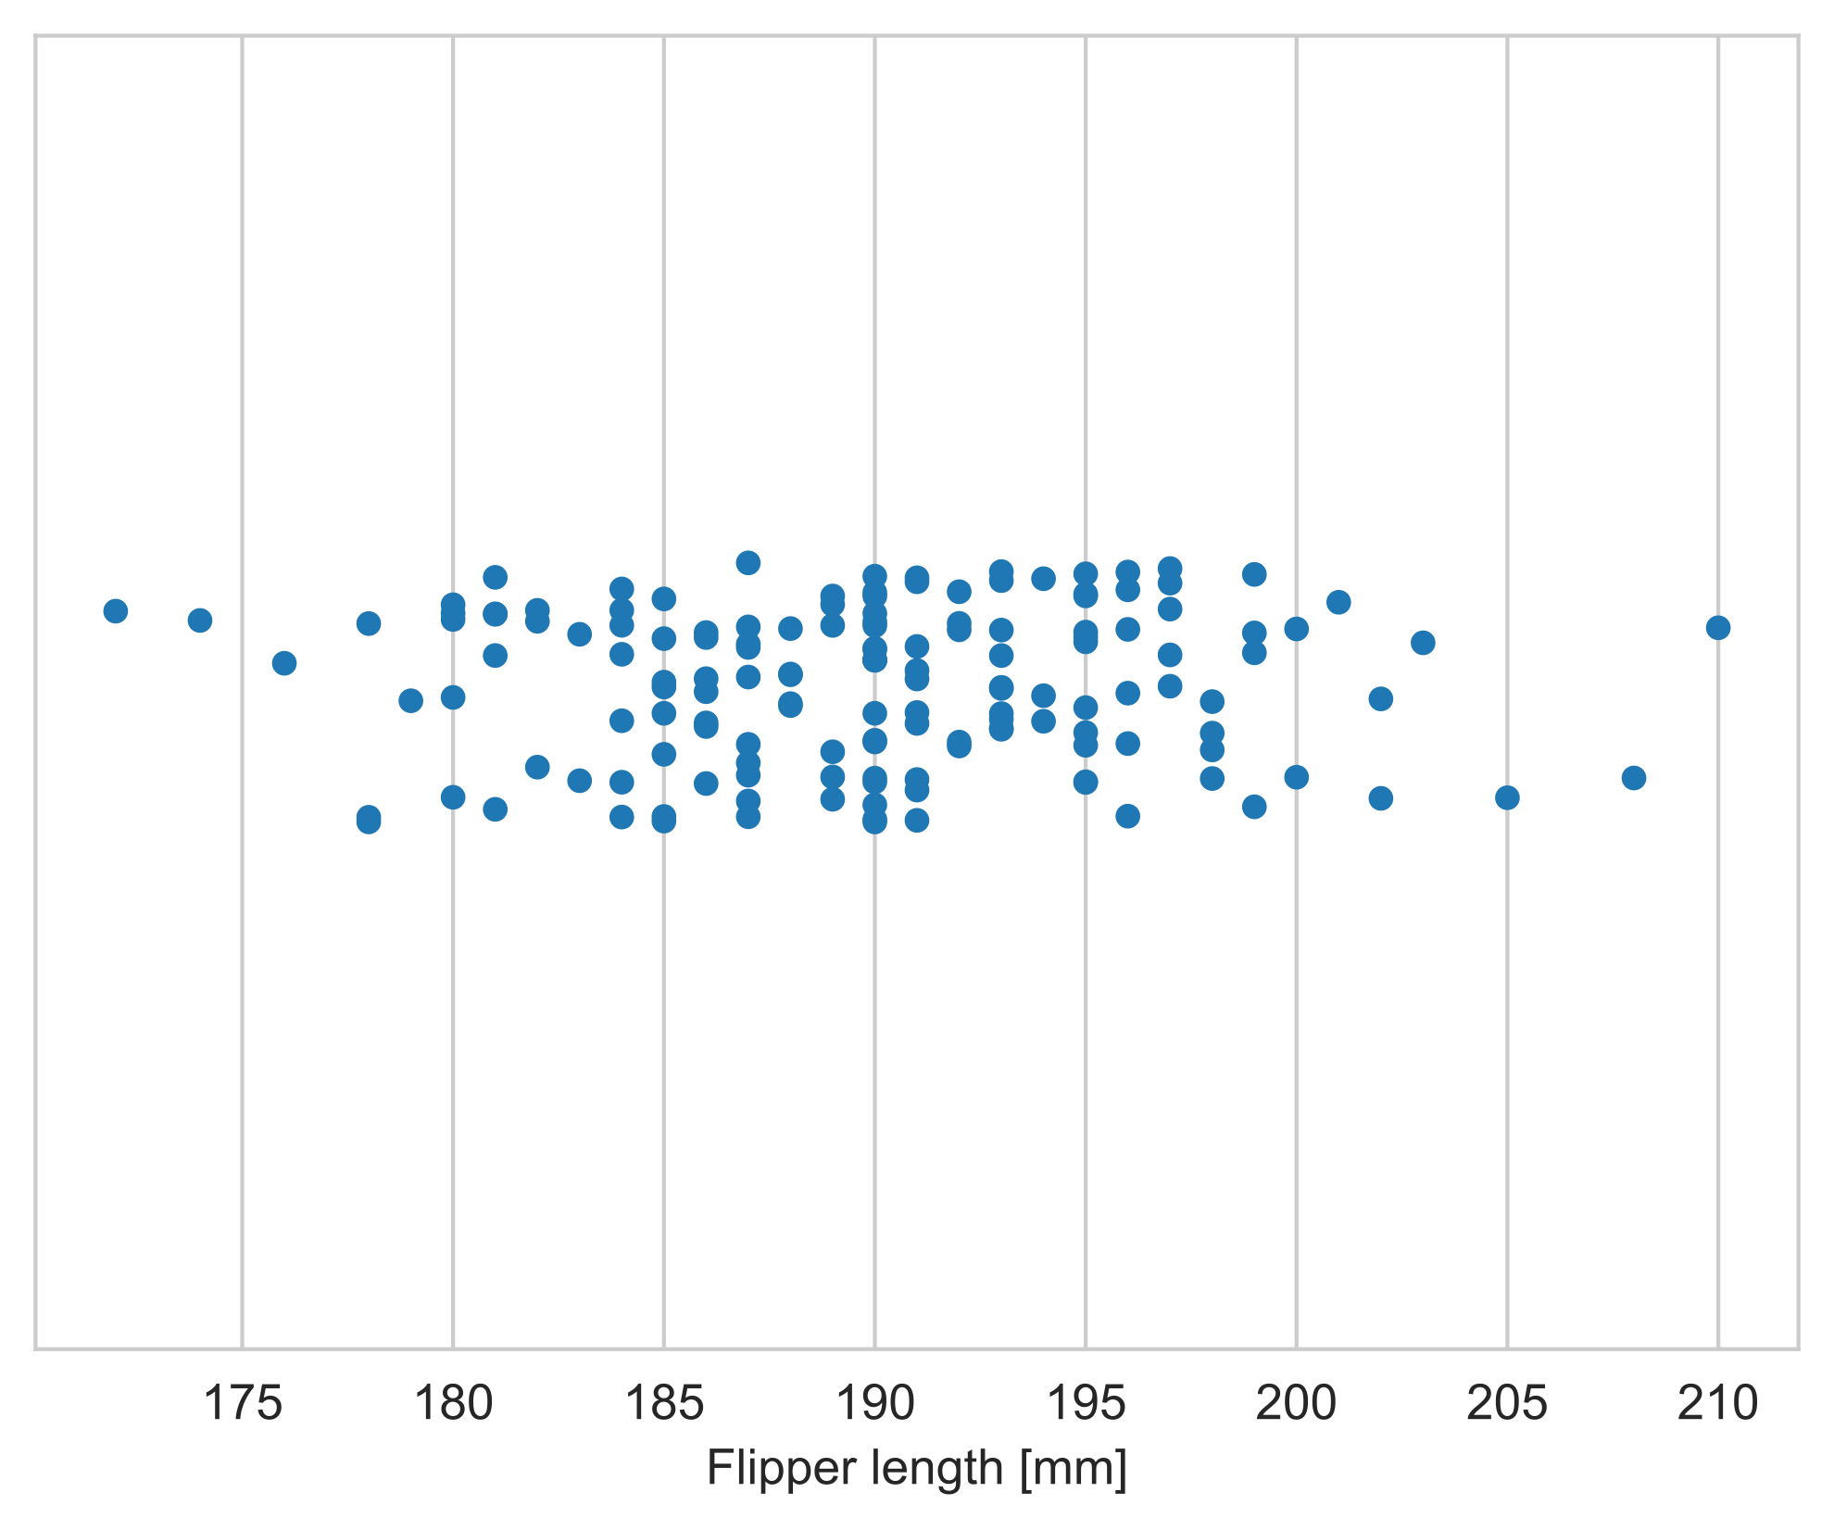
Descriptive Statistics Summarizing data: Measures of Variability
Question:
How would you describe the spread of the data?

Slide 39
Descriptive Statistics Summarizing data: Measures of Variability
Question:
How would you describe the spread of the data?
Some options:
Range (largest minus smallest observed value)
Spread of the data overall
Interquartile range (75th percentile – 25th percentile)
Spread of the middle half of the data

Slide 40
Descriptive Statistics Summarizing data: Measures of Variability
Mean
Question:
How would you describe the spread of the data?
The most popular option:
Average deviation of an observation from the mean
a.k.a.
standard deviation σ
Since we don’t want positive and negative differences to cancel out, we calculate the average of the squared difference (the variance σ² ) and then take the square root again

Slide 41
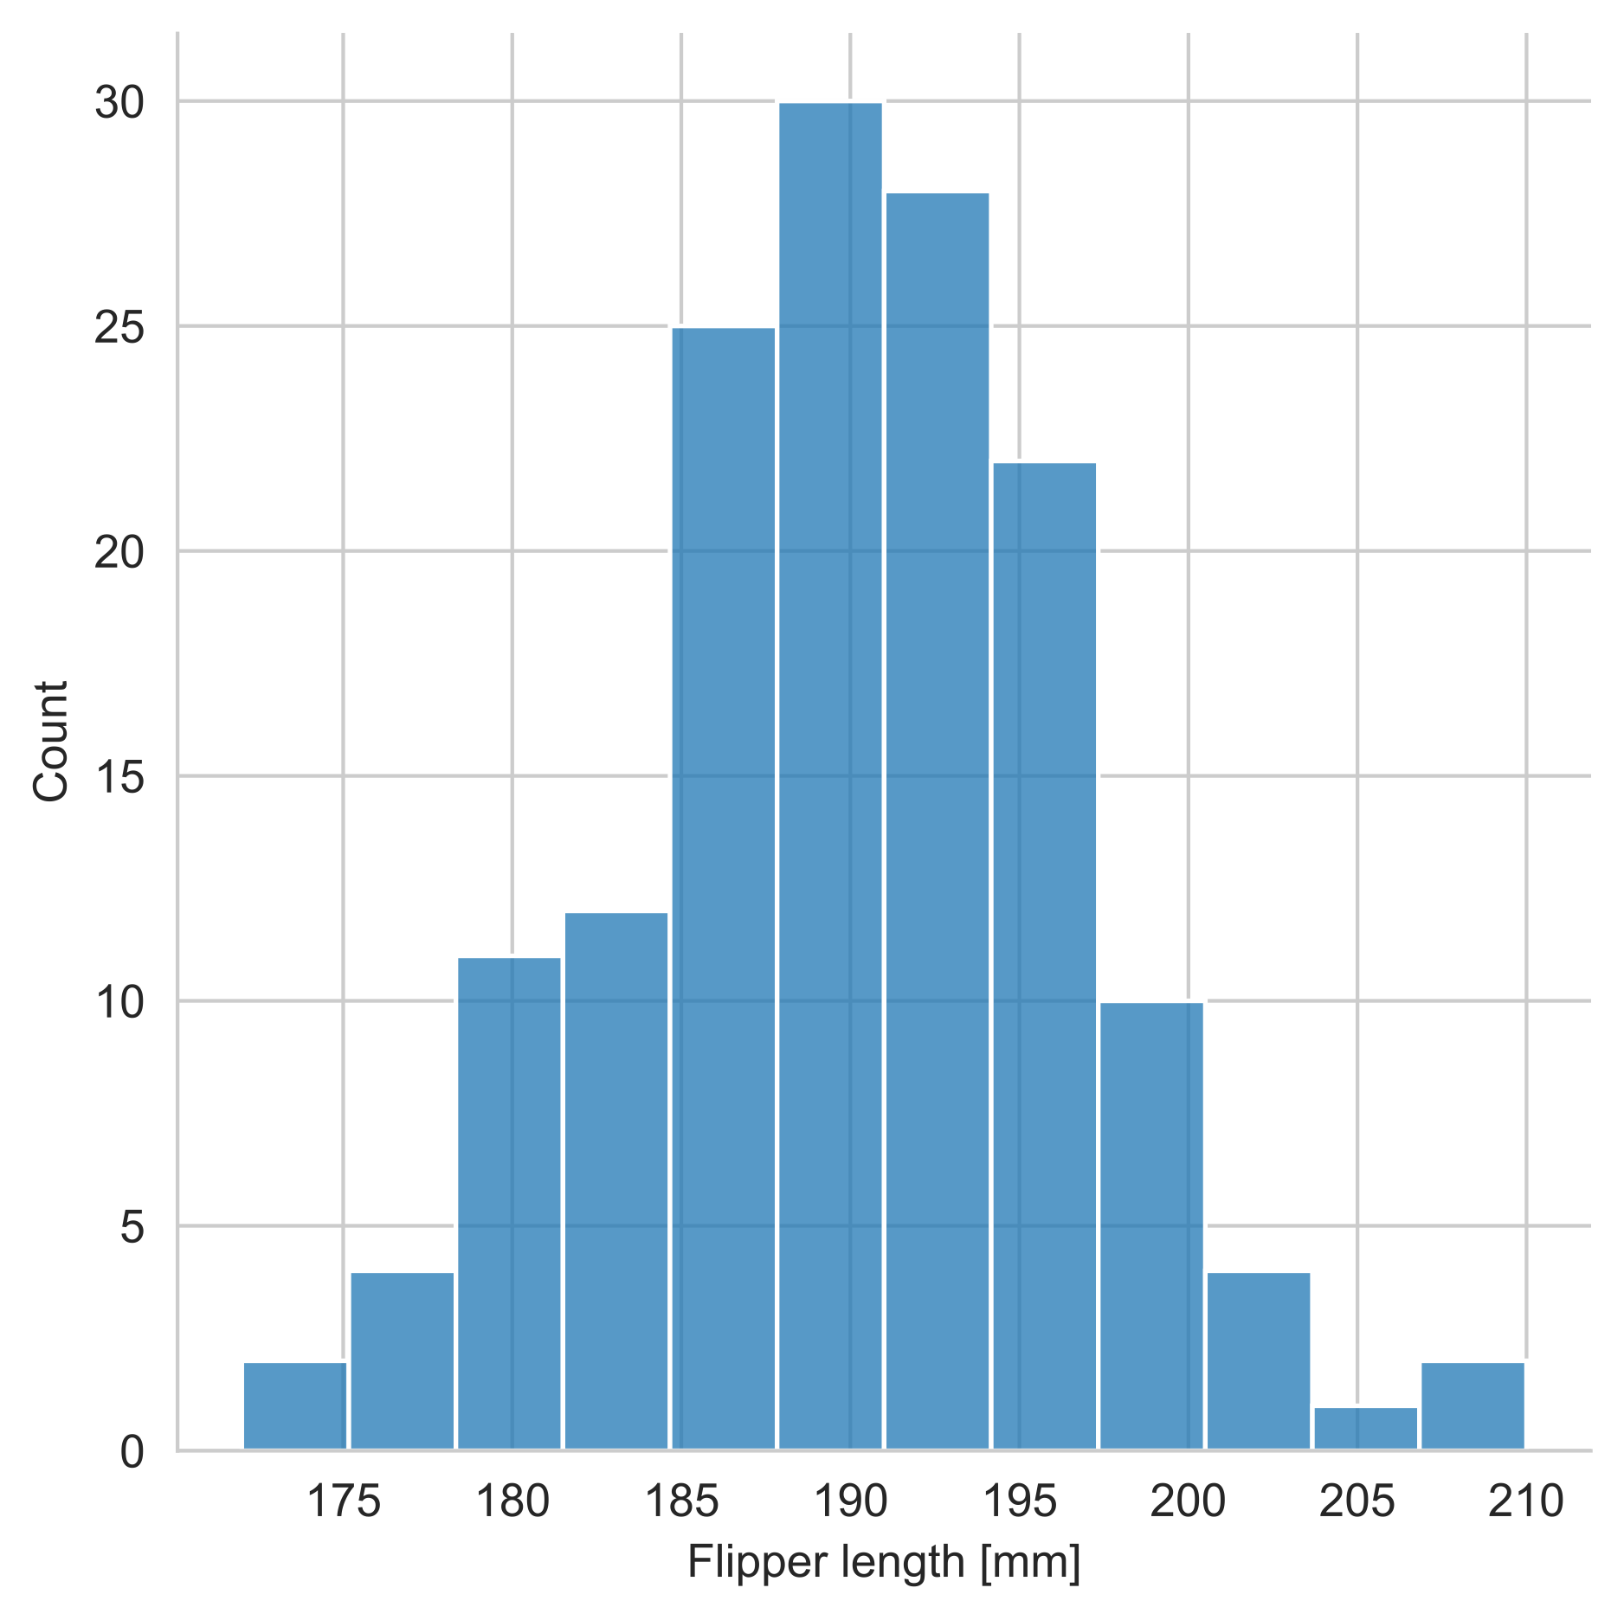
Descriptive Statistics Normal is special
Mean = Median
1σ
1σ
2σ
2σ
3σ
3σ
25th
75th
What makes a distribution “normal”?
The mean and the median are approximately the same
The 25th and 75th percentile are approximately the same distance from the mean
68 % of data are within 1 standard deviation of the mean, 95 % of data are within 2 standard deviations of the mean, 99.7 % of data are within 3 standard deviations of the mean
The “68-95–99.7 rule”

Slide 42
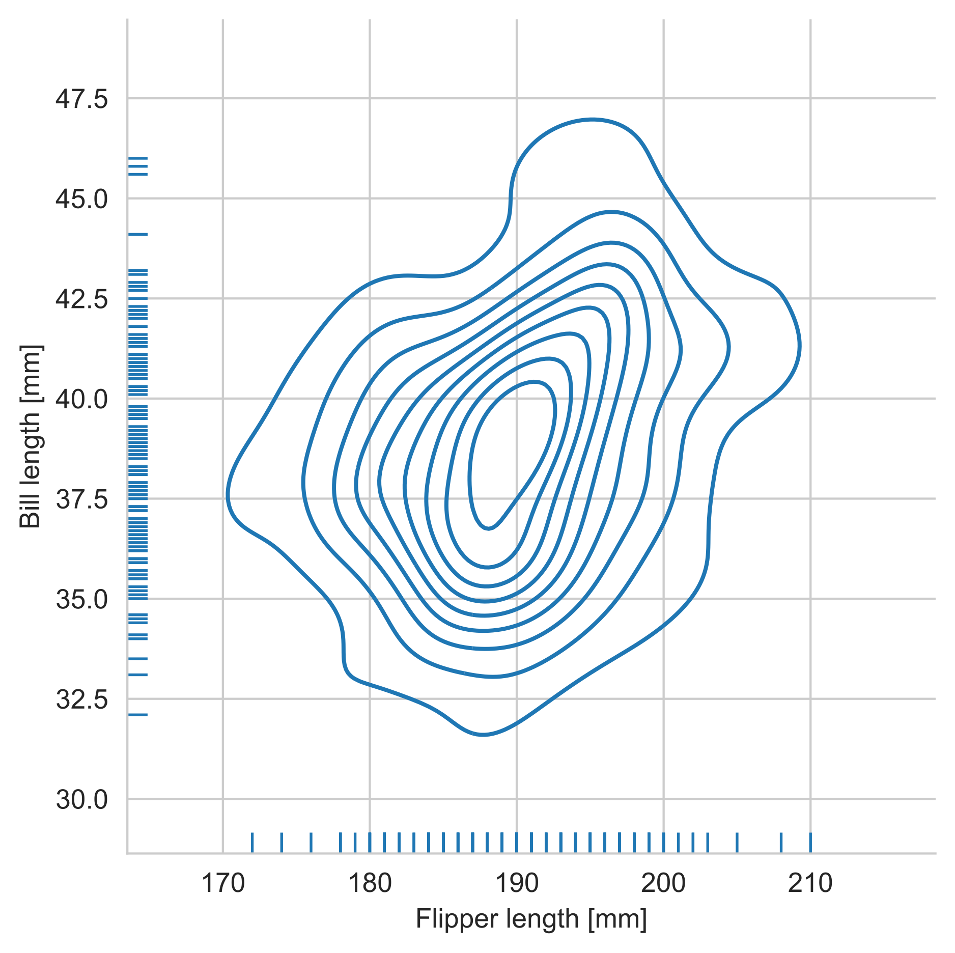
Descriptive Statistics Multivariate distributions
We usually describe an “object” to a machine learning model using multiple variables
So far, we have only looked at the properties of a single variable (univariate statistics)
We can also describe the distribution of multiple variables together (multivariate statistics)
Example:
The distribution of flipper and bill length of Adelie penguins

Slide 43
Descriptive Statistics Key take-aways
Describe data in terms of their distribution, instead of functional
A description consists at least of:
A look at the histogram
A measure of central tendency
A measure of variability
Never trust a mean without variance, or even better: Ask for the histogram!

Slide 44
Inferential Statistics Basic Ideas
How can you tell if two samples are different?
Hypothesis testing
How can you make assumptions based on the data you have seen?
Extrapolations and predictions
Regression and classification
Part of the next two sessions

Slide 45
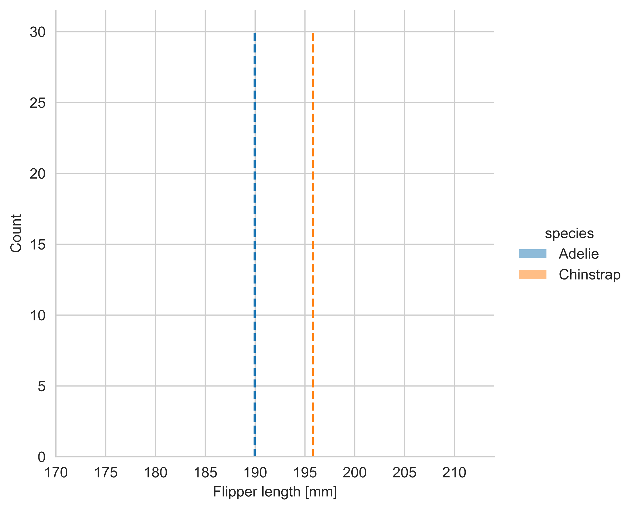
Inferential Statistics Hypothesis Testing
You have two samples
Are they different on average?

Slide 46
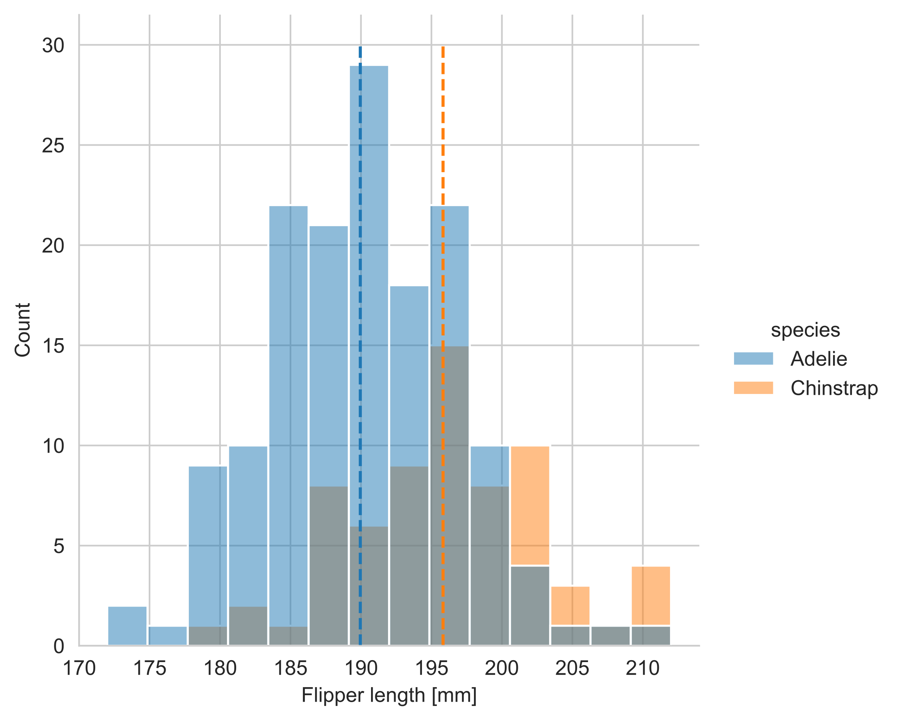
Inferential Statistics Hypothesis Testing
You have two samples
Are they different on average?
Hypothesis testing workflow:
Formulate a hypothesis
“These samples are from the same underlying distribution and just happen to be different because of random chance”
Calculate the difference between the means
Take the variance and the number of observations into account
Calculate how likely it is that the hypothesis is false (p value)
Compare with a threshold probability alpha (e.g., 5 %)
Call it ”significant” if p is less than alpha

Slide 47
Inferential Statistics Making predictions
Naïve predictor
Guess the flipper length of an Adelie penguin!
Always go with the central tendency -> High bias
Go with a random value -> High variance
Fundamental design dilemma in machine learning: Bias-variance tradeoff

Slide 48
Inferential Statistics Making predictions
Naïve predictor
Guess the flipper length of an Adelie penguin!
Always go with the central tendency -> High bias
Go with a random value -> High variance
Fundamental design dilemma in machine learning: Bias-variance tradeoff
Conditional predictor
Given the bill length, guess the flipper length of an Adelie penguin!
Take a slice through the joint distribution

Slide 49
Critical thinking about statistics Visualizations
Pie charts:
Do the percentages add up to (about) 100 %?
Watch for distortions!
Check the sample size!
Bar charts:
Do the units make sense when comparing bars (e.g., number of crimes versus crimes per capita)
Is the scale appropriate or are small differences visually amplified?

Slide 50
Critical thinking about statistics Biased Data
Activity:
What may cause the data or the analysis to be biased?
Some ideas:
Is the measurement technique sufficiently precise?
Is the observed sample representative of the population?
Are the researchers objective? Can the analysis be “blinded”?

Slide 51
Critical thinking about statistics Pitfalls in descriptive statistics
Activity:
How could a sample’s statistics be misrepresented?
Some options:
Small sample size
Using an unsuitable measure of central tendency
Not taking the variability into account
Not checking for significance when comparing samples
Normal is special!

Slide 52
Summary Key take-aways
When you cannot define a deterministic formula to explain a relationship between two variables, we need statistics
There is no absolute certainty in statistics
Statistics let us describe a complex object or process in simple terms
Statistics let us extrapolate from observed and quantified data to “unseen” data

Slide 53
References
Upton, G., & Cook, I. (2008). A dictionary of statistics. Oxford University Press. DOI: 10.1093/acref/9780199541454.001.000
Rumsey, Deborah J. (2019). Statistics Essentials. 1st edition. Hoboken, NJ: For Dummies.

